Slide 1

Detection of fraudulent activities
Group - 9
Prashant Kumar (202018005)
Prashun(202018006)
Abhijeet Kumar (202018042)
Shubham Sharma (202018052)
Instructor: Dr. Ahlad Kumar
T.A :- Subham Nagar , Arpit Pipara

Slide 2
Brief history
Enron corporation was an american company which went bankrupt in Dec 2001.
Enron scam, 2002 was one of the biggest financial scam in US history.
The day after filing for bankruptcy, Enron fired 5,000 workers, one quarter of its 21,000 employees.
An investigation was initiated on top level executives of the firm for hiding losses and manipulating the market.
The Email dataset which we are using was collected for investigation purposes only.

Slide 3
Introduction
The project aims at detecting fraudulent employees from top level executives working at Enron corporation.
We made use of email data and financial data of employees.
The 4 classification models used: LinearSVC using polynomial features, DecisionTreeClassifier, K-Means with LinearSVC and GaussianNB classifiers.
Metrics used: accuracy_score, precision_score, recall_score, f1-score.

Slide 4
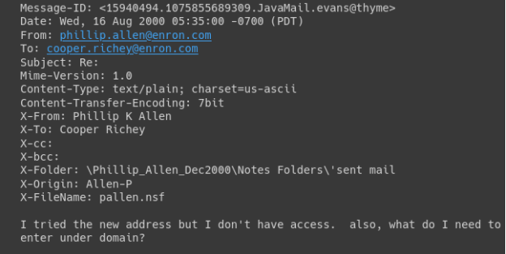
Email Dataset
Email dataset consisted of large corpus of emails sent and received by enron corporation employees. The attachments were removed from the dataset. The dataset that we chose was csv file of 1.3 gb. There were only two columns message id and message text. We extracted important information from message text like From, To, subject and text.

Slide 5
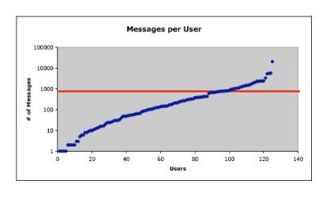
The Enron Corpus
158 users
200,399 emails
Average of 757 emails per user.
Phillip K Allen had most emails sent or received.

Slide 6
Making Email data useful!
MailFromVec
PCA
compressed
MailFromVec
Email text
preprocess
Word2vec training
MailToVec
PCA
compressed
MailToVec

Slide 7
Financial Dataset
There were 21 features including poi feature which reflected which ones were charged with fraud.
We also categorized the features into three groups to further ease our processing.
Payment features e.g. salary, bonus,etc
Stock features e.g. total stock value, exercised stock options, restricted stock
Email features e.g. to_messages, from_this_person_to_poi, from_poi_to_this_person
Some of the new features which we added were
From_poi_ratio
To_poi_ratio
to_shared_ratio
Income_ratio

Slide 8
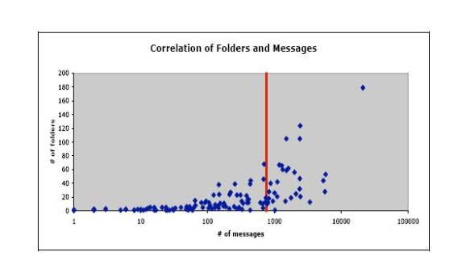
Analysis of Enron Data
Most users used folder to classify their emails
Some users with a lot of emails have only few folders
Users with maximum email indicates more email in each folder

Slide 9
Data Preprocessing
We used standard preprocessing techniques to clean email data like making text lowercase, text stemming, removing stopwords.
For financial data, we imputed NaN values for payment and stock features with median of the columns and for email features we imputed with mean. We also created new features
Like to_poi_ratio, From_poi_ratio, shared _poi_ratio, Income_ratio.
Email text Data
Financial Data

Slide 10
Model
Trained a word2vec model on all email text after preprocessing the text using gensim library.
Two new features added in the financial dataset
MailFromVec and b) MailToVec
Training on 300 dimensional feature vectors seemed infeasible.
Used PCA to make those 300 dimensional vectors down to 30 dimension.
Using the financial features along with these two features we trained the models.

Slide 11
Model
LinearSVC with polynomial features:
DecisionTreeClassifier
Kmeans with LinearSVC
GaussianNB

Slide 12
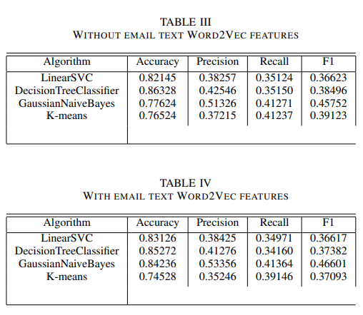
FINAL RESULT
The results after running the final version of the algorithms .

Slide 13

Conclusion
If we consider only accuracy score DecisionTreeClassifier without word2Vec features performed best .
But if we consider only the F1 score then GaussianNB give us the best result in terms of indicating less number of misclassification.
Email vectors did not work as expected.

Slide 14
Thank You

